Slide 1
Toward Fast and Accurate Violence Detection for
Automated Video Surveillance Applications

Slide 2
PROJECT DOMAIN
Deep Learning

Slide 3
TEAM GUIDE Mrs.HIMA VIJAYAN TEAM MEMBERS
Jagadish V [ 111920IT01010 ]
Monesh S G [ 111920IT01016 ]
Naresh G [ 111920IT01305 ]

Slide 4
Abstract:
Better Sorting : By combining special computer techniques (ConvLSTM) and already-trained models for recognizing actions, our system gets really good at telling violent and non-violent actions apart in surveillance videos.
Looking Everywhere, All the Time : Our system pays attention to both where things are happening and when they're happening in the videos. This helps it understand what's going on throughout the whole video.
Learning from Experience : We're using models that have already learned a lot about different actions. This makes our system smarter and better at recognizing a wide range of actions in the videos.
Making Surveillance Easier : Our system could make surveillance easier by accurately and quickly spotting violence. This could help improve security by keeping an eye on lots of videos without needing humans to watch them all.

Slide 5
Existing System
Trouble with Video Quality: Some systems have a hard time dealing with common video issues like compression artifacts, which can make them less accurate.
Expensive and Hard to Maintain: It costs a lot of money and time to keep traditional surveillance systems running, especially if they rely on people or basic rules.
Context Confusion: Traditional systems struggle to understand the situation fully, like telling apart friendly touching from violent actions.
Slow to React: Some systems can't detect violence in real-time, which means they might respond too late to stop a violent event.
False Alarms: Simple systems that just notice movement or follow basic rules can give wrong alerts, especially if there's a lot going on, making people less trusting of the system.

Slide 6
Proposed Sysytem
Dealing with Bad Video Quality: It's built to handle common video issues well, so even if the video isn't perfect, it can still do its job accurately.
Acting Fast: It can make quick decisions in real-time, so if something violent happens, it can respond right away, making places safer.
Getting Things Right: By using this special design for videos (ConvLSTM), it's really good at figuring out complex patterns linked to violence, making its predictions more accurate.
Knowing the Situation: It's smart enough to tell the difference between normal stuff and violence, which means fewer false alarms when something isn't really dangerous.
Understanding Time: This system can understand how actions change over time in videos, which helps it recognize violent acts that develop gradually.

Slide 7
Literature Survey
S.NO | TITLE | DESCRIPTION
1. | Earnest Paul Ijjina, Krishna Mohan Chalavadi “Human action recognition using genetic algorithms and convolutional neural networks “ ,Aug 2016 | Complexity of Human Actions: Recognizing all human actions is hard because people do many different things. Finding the Right Features: It's tough to know which parts of a video are important for recognizing actions. Handling Variability: People perform actions differently, so computers need to learn to recognize actions in various ways.
2. | P. Bilinski and F. Bremond, ‘‘Human violence recognition and detection in surveillance videos,’’ in Proc. 13th IEEE Int. Conf. Adv. Video Signal Based Surveill. (AVSS), Aug. 2016, pp. 30–36. | Finding Enough Examples: It's hard to gather lots of videos showing violence and not violence for teaching computers. Computational Resources: Training and running these models require a lot of computer power, which can be expensive.

Slide 8
Literature Survey
S.No | TITLE | DESCRIPTION
3. | D. Choqueluque-Roman and G. Camara-Chavez, ‘‘Weakly supervised violence detection in surveillance video,’’ Sensors, vol. 22, no. 12, p. 4502, Jun. 2022. | Background Noise: Things like moving objects or changes in lighting can confuse computers, making it harder to spot violence. Ambiguity in Actions: It's hard for computers to understand actions in videos, like if someone is playing or fighting. Ethical Concerns: We must make sure computers don't accidentally target innocent people or invade privacy.
4. | Chhavi Dhiman, Dinesh Kumar Vishwakarma, ‘‘View-Invariant Deep Architecture for Human Action Recognition Using Two-Stream Motion and Shape Temporal Dynamics,’’ in Proc. IEEE, Jan 2020, pp. 3835–3844. | Understanding Different Actions: Teaching computers to recognize various human actions regardless of the angle or viewpoint is tough. Handling Different Perspectives: Making sure computers can recognize actions from different angles or viewpoints. Keeping Up with Movement: Helping computers keep track of fast-moving actions and changes in shape over time..

Slide 9
Literature Survey
S.No | TITLE | DESCRIPTION
5. | Siyuan Yang, Jun Liu, Shijian Lu, Er Meng Hwa, Alex C. Kot, ‘One-Shot Action Recognition via Multi-Scale Spatial-Temporal Skeleton Matching,’’in Proc. IEEE, Jul 2023. | Limited Training Data: With one-shot action recognition, there's not enough examples for each action, making it hard for computers to learn. Matching Skeletons: Computers have to compare skeletons (like stick figures) across different frames to spot actions, which is tricky. Handling Complex Actions: Recognizing actions like walking or running can be easier than complex ones like dancing, which are harder to match accurately. Understanding Body Movements: Computers need to figure out what different body movements mean in different actions.
6. | David Gabriel Choqueluque Roman, Guillermo Cámara Chávez, ‘‘Violence Detection and Localization in Surveillance Video,’’ in Proc. IEEE Int, Nov. 2020. | Spotting the Bad Stuff: Teaching computers to recognize violent actions among normal ones in surveillance videos. Understanding Different Scenes: Helping computers recognize violence even in different settings or lighting conditions. Pinpointing the Problem: Figuring out exactly where the violence is happening in a video. Speedy Decisions: Making computers quick at analyzing videos to detect violence in real-time..

Slide 10
Literature Survey
S.No | TITLE | DESCRIPTION
7. | A. Dosovitskiy, P. Fischer, E. Ilg, P. Hausser, C. Hazirbas, V. Golkov, P. V. D. Smagt, D. Cremers, and T. Brox, ‘‘FlowNet: Learning optical f lowwithconvolutional networks,’’ in Proc. IEEE Int. Conf. Comput. Vis. (ICCV), Dec. 2015, pp. 2758–2766. | Understanding Movement: Teaching computers to understand how things move in videos is hard. Complex Data: Videos have lots of information, making it tough for computers to learn from them. Computational Power: It takes a lot of computer power to teach computers to understand movement in videos. Learning Patterns: Teaching computers to recognize movement patterns in different situations is challenging.
8. | W. Luo, W. Liu, and S. Gao, ‘‘A revisit of sparse coding based anomaly detection in stacked RNN framework,’’ in Proc. IEEE Int. Conf. Comput. Vis. (ICCV), Oct. 2017, pp. 341–349. | Data Complexity : Understanding complex patterns in data using stacked RNNs is challenging. Sparse Representation : Capturing rare and unusual events in data with sparse coding can be difficult.. Training Efficiency: Training stacked RNNs on large datasets can be time-consuming and requires efficient algorithms.

Slide 11
Literature Survey
S.No | TITLE | DESCRIPTION
9. | VIKTOR DÉNES HUSZÁR, VAMSI KIRAN ADHIKARLA, IMRE NÉGYESI AND CSABA KRASZNAY, ‘‘Toward Fast and Accurate Violence Detection for Automated Video Surveillance Applications,’’ IEEE Trans., Feb. 2023. | Teaching Computers about Different Situations: Computers need to recognize violence even when things like lighting or how people move change. Environmental Robustness: Ensuring system effectiveness under varying environmental conditions. Making Computers Fast: It's tough for computers to quickly watch videos and decide if there's violence.
10. | D. Tran, H. Wang, L. Torresani, J. Ray, Y. LeCun, and M. Paluri,‘‘A closer look at spatiotemporal convolutions for action recognition,’’ in Proc. IEEE/CVF Conf. Comput. Vis. Pattern Recognit., Jun. 2018,pp. 6546–6555. | Understanding both space and time: Actions in videos involve knowing what's happening and when, which is tough for computers. Dealing with messy data: Videos can have bad lighting, shaky cameras, and other problems that confuse computers. Variety in Actions: Actions can be fast, big, or complicated, making it tricky for computers to recognize them all accurately.

Slide 12
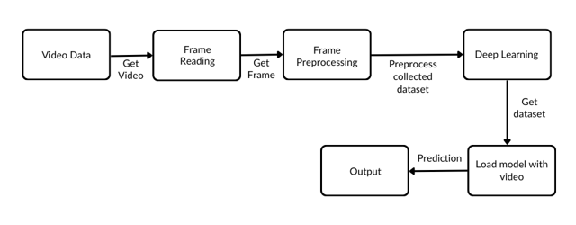
Architecture Diagram:

Slide 13
List of Module :
Data Procurement
ConvLSTM-Based Model Architecture
Feature Embedding
Real-time Classification [Live Classification]
Anomalous behavior identification

Slide 14
Module Description
S.NO | MODULE | DESCRIPTION
1. | Data Procurement | Collect surveillance video data from various sources, which may include public datasets or proprietary surveillance feeds. Preprocess the data by resizing, normalizing, and splitting it into smaller video clips or frames for input to the model.
2. | ConvLSTM-Based Model Architecture | The core of the system is a deep learning model designed with Convolutional Long Short-Term Memory (ConvLSTM) layers. ConvLSTM layers combine the capabilities of convolutional layers (for spatial information) and LSTM layers (for temporal information) within a single architecture. This integration allows the model to process video sequences, effectively capturing both spatial and temporal features in the surveillance video data. The ConvLSTM layers enable the model to understand the dynamic relationships between actors and objects, vital for violence detection.

Slide 15
Module Description
S.NO | MODULE | DESCRIPTION
3. | Feature Embedding | The ConvLSTM layers are responsible for extracting relevant features from the input video frames or clips. These features represent the spatial and temporal aspects of the video data, enabling the model to recognize patterns and movements associated with violent activities.
4. | Real-time Classification [Live Classification] | In real-time surveillance video processing, the system uses the ConvLSTM-based model to classify video segments as either violent or non-violent based on the learned features. The model is capable of making continuous predictions, allowing for timely responses to violent incidents as they occur.

Slide 16
Module Description
S.NO | MODULE | DESCRIPTION
5. | Anomalous behavior identification | Once validated, the system can be integrated into surveillance applications for automated violence detection with True (or) False Identification.

Slide 17




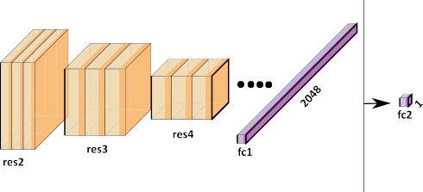
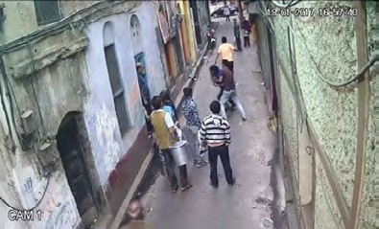

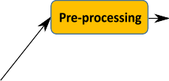

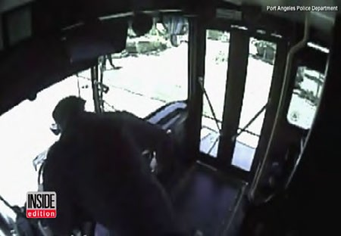
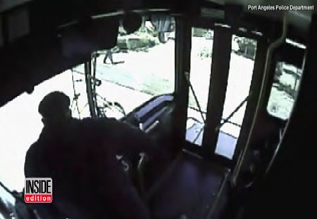
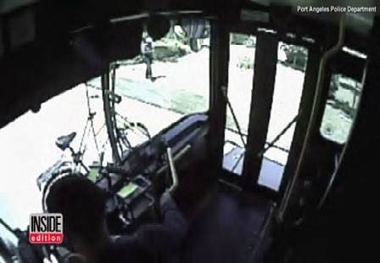
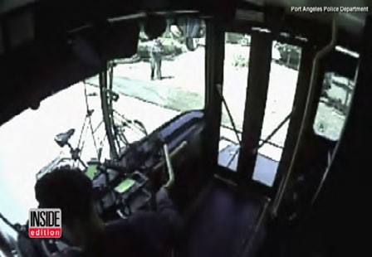
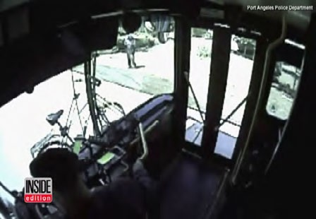
Spatio-temporal features extraction using trimmed Conlstm model
Data Flow Diagram

Slide 18

OUTPUT

Slide 19
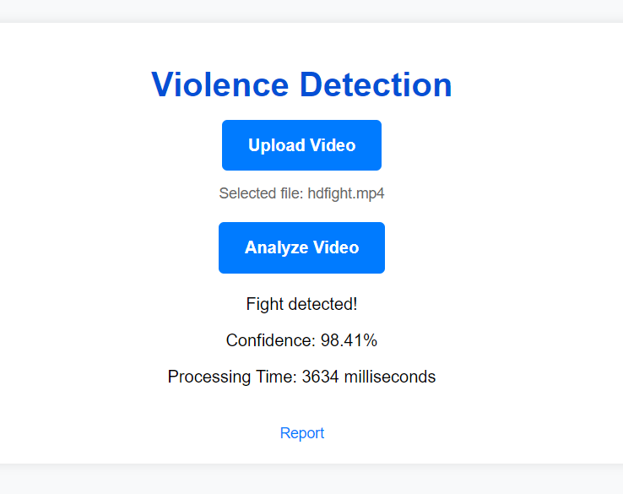
OUTPUT

Slide 20
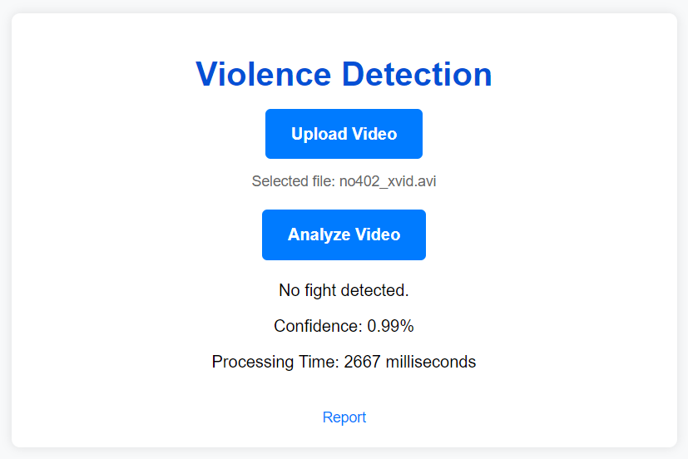

Slide 21


Slide 22
Software Requirements:
* Operating System : Windows 10 (64 bit)
* Software : Python
* Tools : Jupyter Notebook (anaconda)
Hardware Requirements:
* Hard Disk : 500GB and Above
* RAM : 4GB and Above
* Processor : I3 and Above

Slide 23
THANK YOU

